Slide 1

DocInsight AI: An Intelligent Document Analysis and Question Answering System
COURSE : DSA0306 NATURAL LANGUAGE PROCESSING
Presented by:
Aswanth N N 192424123
Vasantha Nithi D Y 192424137
G Aswartha Manidheep 192425089
Mohammed Jameel A 192425057

Slide 2

INTRODUCTION
DocInsight AI is an intelligent document analysis system that uses Artificial Intelligence (AI) and Natural Language Processing (NLP) to process and understand documents.
It supports multiple document formats such as PDF, Word (DOCX), and scanned images (JPG/PNG).
The system extracts text from scanned documents using Optical Character Recognition (OCR), making non-editable documents searchable.
It generates summaries, extracts key insights, and enables semantic search to help users quickly locate relevant information.
Users can ask questions in natural language, and the system provides accurate answers based on the uploaded document using Retrieval-Augmented Generation (RAG).

Slide 3
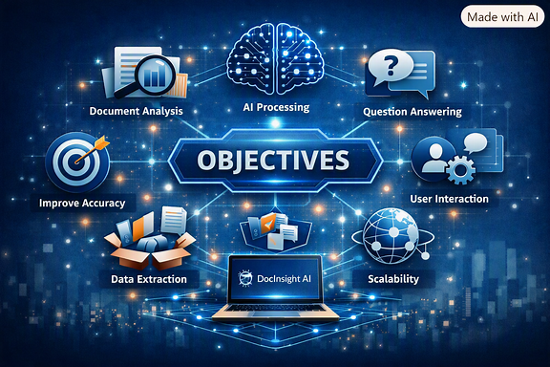
OBJECTIVES
Develop an intelligent system that automatically extracts text from digital and scanned documents.
Reduce the time required to read and understand lengthy documents by generating concise summaries.
Enable semantic search that retrieves information based on meaning rather than exact keywords.
Provide accurate context-aware answers by combining document retrieval with Large Language Models (LLMs).
Improve document accessibility through language translation and text simplification for diverse users.

Slide 4
PROBLEM STATEMENT
Organizations and students often deal with large volumes of documents that require significant time to read and analyze.
Scanned documents cannot be searched directly without OCR, making information retrieval difficult.
Traditional keyword-based search frequently fails to identify relevant content when different wording is used.
Manual document summarization is time-consuming and may overlook important information.
Existing systems generally lack integrated features such as OCR, semantic search, AI-based question answering, and multilingual support.

Slide 5
EXISTING SYSTEM
Most existing systems provide only basic document viewing and keyword-based search functionality.
OCR support is limited, resulting in poor extraction accuracy for scanned or low-quality documents.
Document summarization and insight generation are either unavailable or require separate tools.
Search methods rely on exact keyword matching rather than understanding the context or meaning.
Users cannot interact with documents through natural language questions or receive AI-generated responses.

Slide 6
PROPOSED SYSTEM
It uses Optical Character Recognition (OCR) to extract text from scanned documents and images.
Applies Natural Language Processing (NLP) techniques to generate summaries and extract important insights.
Implements Semantic Search using sentence embeddings and vector databases to improve information retrieval.
Integrates Retrieval-Augmented Generation (RAG) with Large Language Models (LLMs) for context-aware question answering.
Supports language translation and text simplification to enhance accessibility and user understanding.

Slide 7
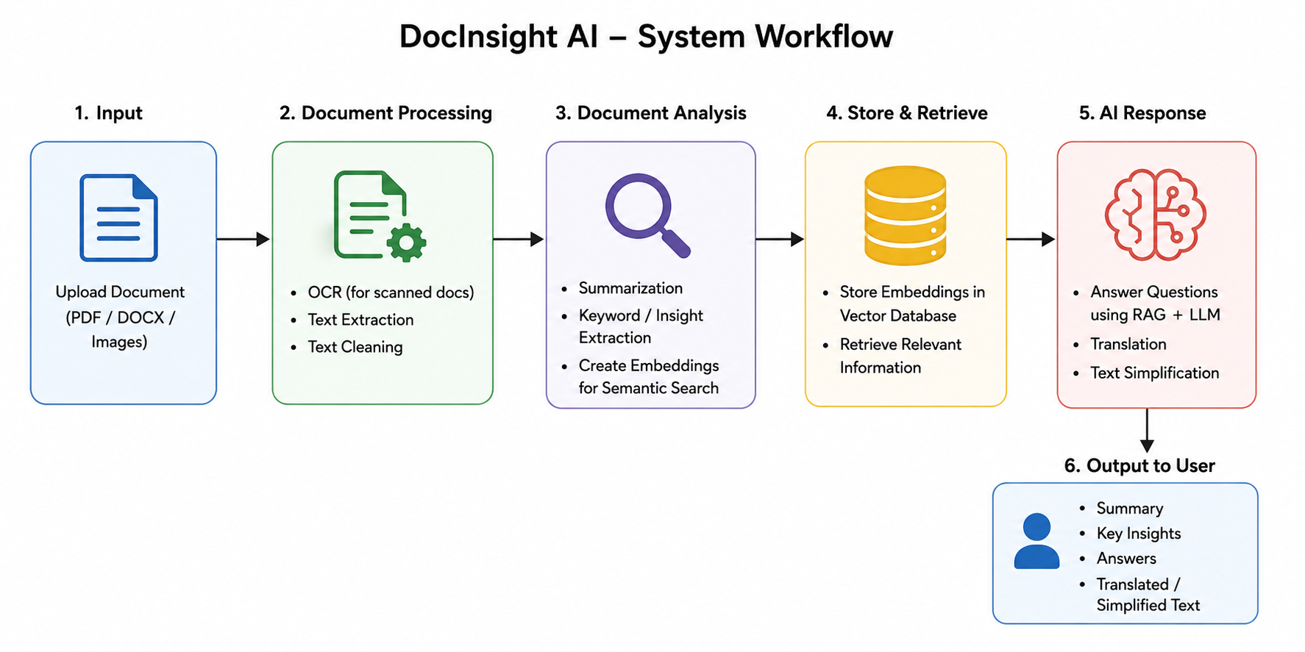

Slide 8
Module 1 – Intelligent Document Processing
Accept and validate uploaded documents (PDF, DOCX, JPG, PNG).
Extract text from scanned and digital documents using OCR.
Perform image enhancement and text preprocessing for better accuracy.
Clean and organize extracted text into a structured format.
Store processed text for further analysis.
Techniques Used: OCR, Image Preprocessing, Text Cleaning, OpenCV, EasyOCR/Tesseract

Slide 9
Module 2: Document Intelligence & Insight Generation
Generate concise summaries of lengthy documents.
Extract important keywords and key phrases.
Identify entities such as people, organizations, and locations.
Highlight important insights and document topics.
Prepare processed content for semantic search.
Techniques Used: NLP, Text Summarization, Keyword Extraction, Named Entity Recognition (NER), Hugging Face Transformers

Slide 10
Module 3: Semantic Search & Knowledge Retrieval
Convert document text into vector embeddings.
Store embeddings in a vector database for fast retrieval.
Perform semantic search based on the meaning of user queries.
Retrieve and rank the most relevant document sections.
Provide contextual information for the question-answering module.
Techniques Used: Sentence Transformers, Semantic Embeddings, FAISS/ChromaDB, Cosine Similarity

Slide 11
Module 4: AI-Powered Question Answering & Language Assistance
Accept user questions in natural language.
Retrieve relevant document context using RAG.
Generate accurate, context-aware answers using LLMs.
Translate document content into multiple languages.
Simplify complex text for improved readability.
Techniques Used: Retrieval-Augmented Generation (RAG), Large Language Models (GPT/Llama), LangChain, Machine Translation

Slide 12
THANK YOU

